Slide 1

B.Tech External Project Evaluation, VIIIth Sem
Project Title- A SYBIL RESISTANT SCALABLE BLOCKCHAIN-TRUSTCHAIN
Under the Supervision of:-
Mr. TUSHAR MEHROTRA
Assistant professor,
Sharda University, Gr. Noida
Presented by :
Abhishek Kumar, 2019005482
Bashant Kumar Sah, 201907919
DEPARTMENT OF COMPUTER SCIENCE & ENGINEERING
SHARDA SCHOOL OF ENGINEERING AND TECHNOLOGY
May 2022
1

Slide 2
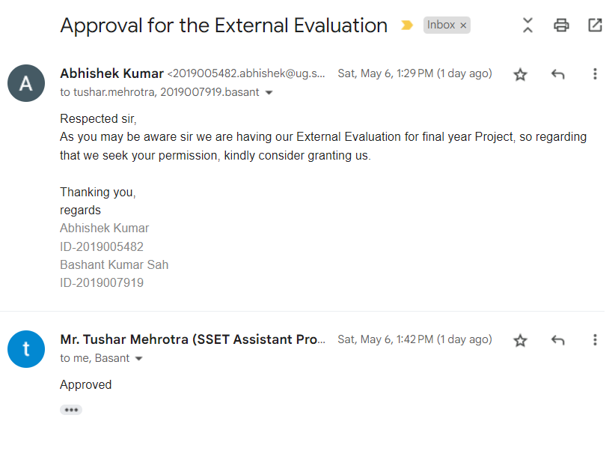
Approval from guide for the evaluation

Slide 3
Contents of the Presentation
Introduction to the project
Motivation for the project
Problem Statements/Objectives of the Project
Literature Survey
Workload distribution/ Team Work
Project Planning
Screenshot of the Approval of the Certificate of the Project Report
Methodology used
Solution Approach
Algorithms and framework
Outcome Produced
Proof of the Outcome

Slide 4
Introduction to the project
Trust Chain is an unlicensed data structure that keeps records of the activities of nodes. Trust chain is an idea to avoid double spending attacks in cryptocurrency Transaction in blockchains.
Trust Chain is a procedure where we proposed a system Network observer and Peer alert system to overcome the issue in the existing system.
We are using a peer alert system to notify the sender and the receiver about the unauthorized transaction, A peer alert system is designed to such that the message is passed from the fraudulent node to the sender node to the sender and the receiver nodes.

Slide 5
Motivation for the project
To develop a network observe model which can detect double spending problem with better accuracy.
To develop a peer alert system to authenticate a transaction.
To develop trust between sender and receiver so then can accept digital currency.
Save sender and receiver’s time.

Slide 6
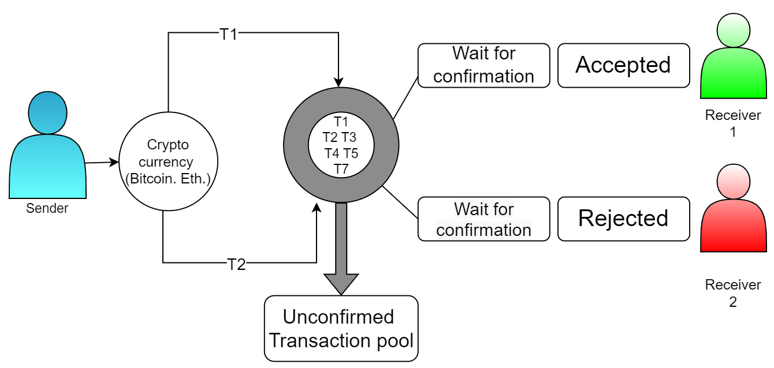
Problem Statements/Objectives of the Project
The procedure of generating Trust chain to avoid Double Spending problem in blockchain. A double-spend problem is one when a malicious user sends some amount of currency to another user and before that amount being debited in his account and replicated throughout the network, he makes another transaction with that already spent currency. The Trust chain a procedure to avoid this problem.
Fig. No.1 Double Spending Problem

Slide 7
Literature Survey
S.No. | Authors ,Name of the paper and Year | Objectives | Algorithm / Methodology | Advantage | Conclusion
1 | Steffen et al “A trust based delegation system for managing access control”. 2005 | Provide a cutting-edge delegation system that explains digital trust between users using tokens that are cryptographically safeguarded | Access control involves identifying a user based on their credentials and then authorizing the appropriate level of access once they are authenticated. | For mobile clouds, conventional access control approaches are inadequate. | For ubiquitous applications, the delegation system that is being discussed enables a safe and user-friendly trust-based access control method. More permission restrictions, such as increased context awareness or permissions that are only granted in certain circumstances, will be the subject of future study.
2 | Yadav et al. “A scalable trust based consensus mechanism for secure and tamper free property transaction mechanism using DLT” 2022 | The current system has a number of problems and openings that lead to disputes and corruption in property. | Time required for message exchange per consensus is lesser by 59.01% than the PoW mechanism and takes 11% less time than the load-based approach. | Performance is measured by changes in the number of miners. | The distributed and secure P2P network infrastructure for real estate transactions is suggested in this article. This increases system transparency and lowers risks by using the block-chain to store property transactions in a distributed manner.

Slide 8
Literature Survey
3 | Yadav et al.”Distributed Ledger Technology-based land transaction system with trusted nodes consensus mechanism “. 2022 | A new option for many financial applications that need a safe and unchangeable transactions mechanism is blockchain technology. | Distributed Ledger Technology (DLT)-based systems. | Each miner traverses a set number of blocks to retrieve the buyer and seller data. | The management of real estate transactions has been suggested using a blockchain-based system. The suggested structure is intended to remedy the flaws in the current system of land registration. The suggested blockchain-based system may be used to map all facets of property transactions.
4 | Smetanin et al.”Blockchain evaluation approaches :State-of-the-art and future perspective”. | Focus to changing away from examining the technology's potential and toward developing solutions based on distributed ledger technology, signalling that the current growth in interest in blockchain-based systems is already hitting a tipping point. | Identify current challenges of the blockchain analysis from the system evaluation perspective, as well as provide future perspectives. | It should be mentioned that a few small projects have been created to examine a specific aspect of the blockchain operation. | They identified current challenges and future prospects of blockchain simulation approaches, which include a lack of expertise, the need for developing a multi-task benchmark for reliable models’ comparison, gaining access to the representative historical data of blockchain systems, evaluating the influence of abstractions on the model accuracy, exploring relations between blockchain characteristics, reducing computational resources for simulation, and the usage of machine learning for better performance.

Slide 9
Literature Survey
5 | Yadav et al.""Sidechain: storage land registry data using blockchain improve performance of search records." 2022 | To acess data main chain and side chain as two distinct sorts of blockchains. Non-transactional data, including images, contracts, PDFs, and other related material, is saved in the sidechain while publicly viewable metadata is kept in the mainchain. | A side chain is a blockchain that runs parallel to the main chain. It extends the functionality of an interoperable blockchain network. | This article proposes a query algorithm for searching and adding the land record in the blockchain. | The registration office uses the summary file to search records in the main chain in order to get block hashes and property record numbers. Based on the property record number, it searches for similar records and gives the buyer access to those records.
6 | Sharma et al.”Towards Unification of Statistical Reasoning, OLAP and Association Rule Mining “ 2022 | Online analytical processing (OLAP) and association rule mining have both come into existence, each with their own justifications and goals. | A transaction, as previously stated, is a bit vector. For the sake of simplicity, Let’s start with some notation that makes it possible to treat a transaction as an item set. | To translate OLAP inquiries to SR, or probability theory, we employ OLAP queries. | the semantic resemblances among the three DSTs will be useful in the creation of a few next-generation hybrid decision support systems.

Slide 10
Literature Survey
7 | Yadav et al.”The efficient consensus algorithm for land record management system “ 2021 | It is built on blockchain technology, with the goal of streamlining the registration process by bringing all registrar offices under one framework. | Let’s start with some notation that makes it possible to treat a transaction as | 1.The round-robin consensus algorithm and our modified round-robin consensus method have been compared. 2.Our Property Registry Transaction System has operated successfully on a number of hosts. | In this work, two consensus techniques for the IPFS-based property registration transaction system are compared.We have used IPFS to build blockchain on several hosts in order to do this.
8 | Malik et al.”Trust chain: Trust management in blockchain and iot supported supply chains “ 2019 | Among these technologies, statistical reasoning was frequently utilised to clarify data-driven conclusions. Later, we witnessed the rise of association rule mining and online analytical processing (OLAP), both of which have distinct purposes and goals. | we propose TrustChain, as a three-layered trust management framework which uses a consortium blockchain to track interactions among supply chain participants and to dynamically assign trust and reputation scores based on these interactions. | The reputation-based market segmentation and priority-value-order processes, which provide high-reputation sellers access to more and better offers from buyers and also let buyers sort offers based on reputation and price, increase the system's effectiveness. | The framework also offers a reputation model that is asset- and agent-based, enables smart contracts for automation and efficiency, and may assign participants to different products with different reputations.

Slide 11
Literature Survey
9 | Kaboli et al. ”An experimental study of the relationship between trust and inventory replenishment in triadic supply chain “ 2012 | We take into account two different kinds of trust: customer and supplier trust. | We investigate the relationship between trust and inventory replenishment decision indicators in a triadic (three-echelon) serial supply chain | order size and the interval between orders The findings show that retailers interpret weak market demand as erratic swing orders, which increases the unpredictability of order quantity and turnaround time. | Second, take into account the dynamics of trust in the game and the link between trust and the choice to replenish inventory, which hasn't been well explored in previous studies
10 | Nicolas et al.”Blockchain software patterns for the design of decentralized applications “ 2022 | the help of a network of peers, each of whom has a copy of the ledger, the blockchain technology is a distributed ledger made up of blocks. | blockchain qualities can also be liabilities, depending on the context. The transparency and immutability of a blockchain can put personal or confidential data at risk. Even encrypted, it is unsure if the data are safe because of potential advances in data decryption or key leakage. | The second subcategory compiles seven patterns that control and store data off-chain while adding a second degree of security utilising blockchain technology. | This study also advances the state of the art for blockchain-based patterns by developing a taxonomy that will aid in categorising newly developed patterns, mapping and describing the body of literature on blockchain-based patterns within the taxonomy, and identifying research gaps that could be filled in future studies.

Slide 12
Workload distribution / Team Work
S.N. | Name of Student | Assigned Role
1. | Abhishek Kumar | Implementation of Project, Module Designing, Review Paper
2. | Bashant Kumar Sah | Research work, Research paper

Slide 13
Project Planning
January, 2022
February, 2022
March, 2022
April, 2022
May, 2022
Enhanced Implementation and Literature Survey to support
decision-making
And function selection
Quantification and
completeness of
Functional
Specifications
Implementation of Project
Research Paper publication
Final project report and External evaluation PPT

Slide 14
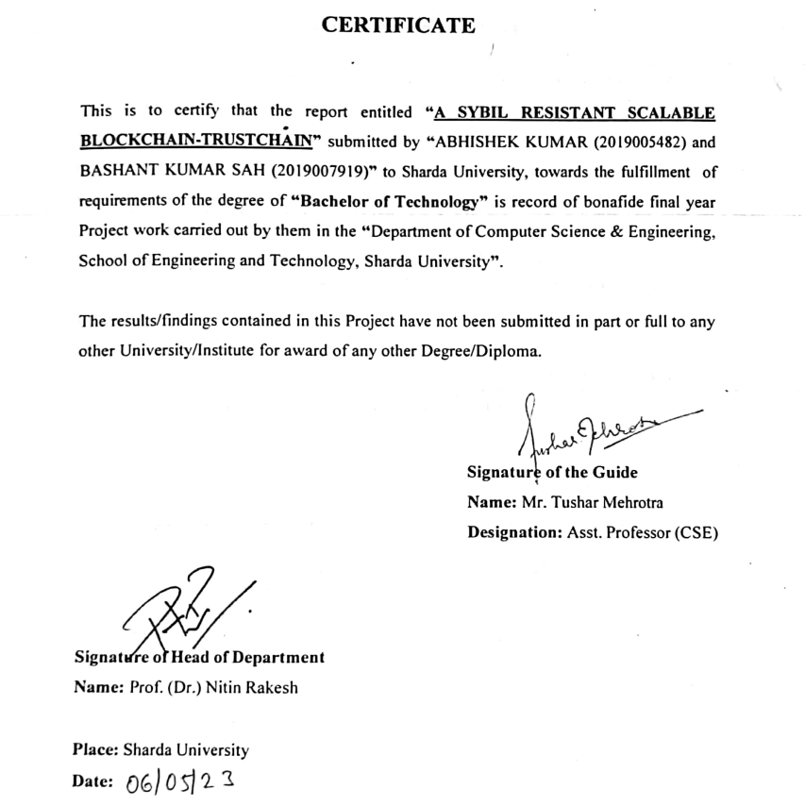
Screenshot of the Approval of the Certificate of the Project Report

Slide 15
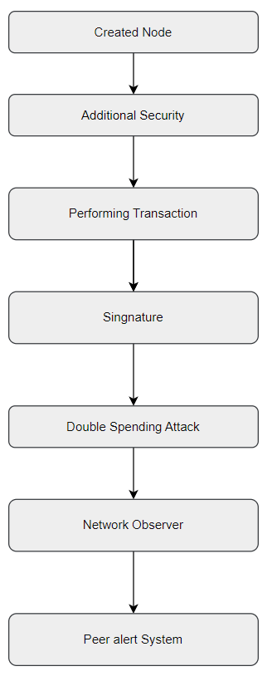
Methodology used

Slide 16
Solution Approach
1. Created nodes
To start the initial blockchain, we created nodes using node.js
2. Additional Security
To increase security, a random nonce generator is used, that will be used in the hash creation. Moreover, to increase the time taken to mine individual blocks, a difficulty index is used to append additional zeros to the generated hash, which increases the mining time complexity. Also to validate the cryptocurrency blockchain, for every pair consisting of the current block and its preceding block, a two-fold validation methodology is utilized.
The hash of the current block is recomputed with the same nonce, and the original and recomputed hash values are compared.
The preceding hash of the current block and the hash of the preceding block are compared.
If a mismatch is found in either of these two steps, the validation function returns an error.

Slide 17
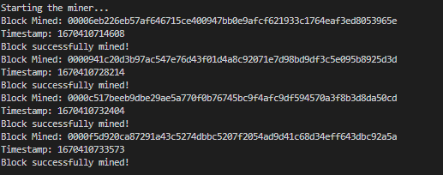
Solution Approach
3.Performing Transactions
To perform transactions between the intended sender and recipient blocks or nodes, their addresses are mined, such that the transaction amount can be deducted from the sender node and added to the receiver node. An array contains the records of pending transactions for every block starting with a null amount transaction for the genesis block, and subsequently stores every new transaction.
Fig. No.2 Performing Transactions

Slide 18
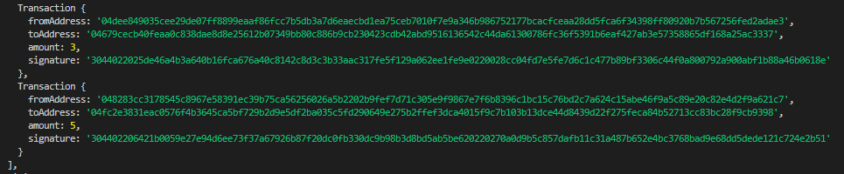
Solution Approach
4.Signature
To ensure that every transaction is unique, it is signed with a signature which is generated using the private and public key and calculated hash for a block, using the elliptic library.
Fig. No.3 Signature

Slide 19
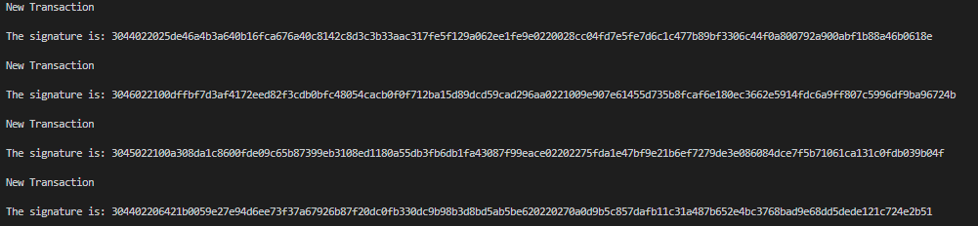
Solution Approach
5.Double Spending Attack
Double Spending Attack When a sender tries to perform the same transaction (with the same amount) twice, but with two different receivers, even though his initial balance is not sufficient to satisfy both the transactions, a double spending attack occurs.
Fig. No.4 Double Spending Attack

Slide 20
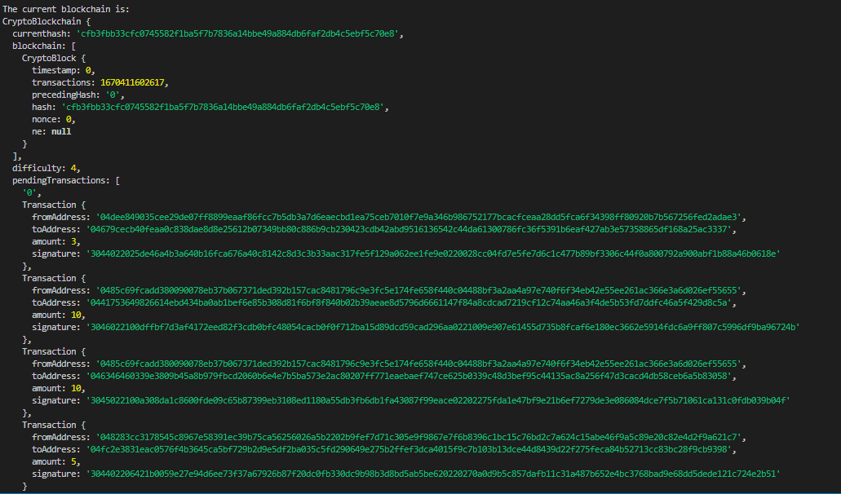
Solution Approach
6.Network Observers
Network observer will check the number of pending transactions from a particular sender address in a blockchain. If the payment amount of two pending transactions from that address is the same, and the total amount is greater than the initial balance of the sender, a transaction aborted error will be displayed, and the user will be prompted to either cancel the last transaction with the same amount, or to try performing the transaction later.
Fig. No.5 Network Observer

Slide 21
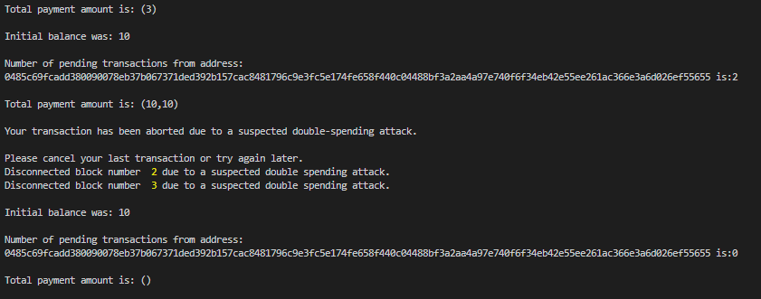
Solution Approach
7. Peer Alert System
Peer Alert Systems: In order to disconnect from the block where the fraudulent transaction or double spending attack has taken place, the neighbouring blocks are alerted. Any subsequent transactions that are scheduled for this block are redirected to other routes, and these neighbouring blocks terminate their connections with it. The sender (who wanted to conduct the double spending attack), has to either withdraw any one of the transactions within a given timeout period, or will be blocked temporarily before being able to perform any new transactions again.
Fig. No.6 Peer Alert System

Slide 22
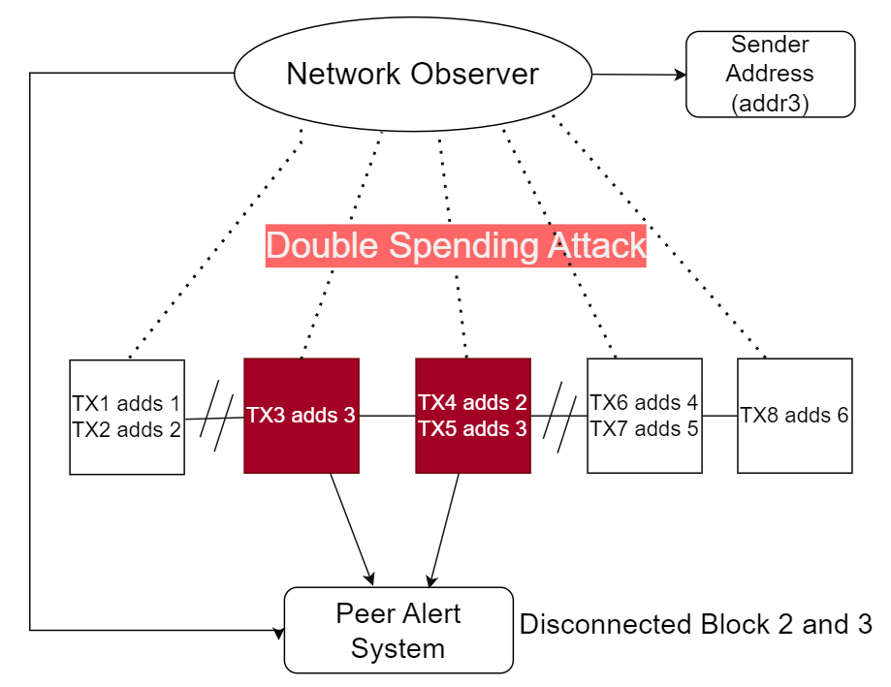
Algorithms and framework
Fig. No.7 Network observer

Slide 23
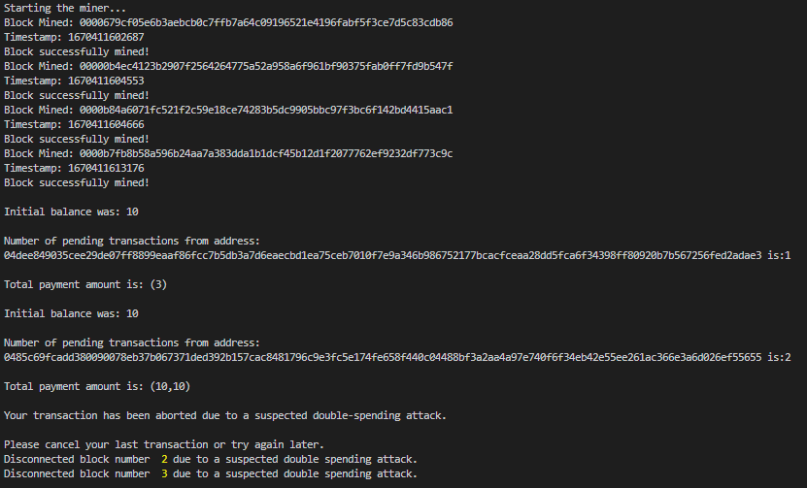
Outcome Produced &Proof of the Outcome
Fig. No.8 Network observer Output

Slide 24
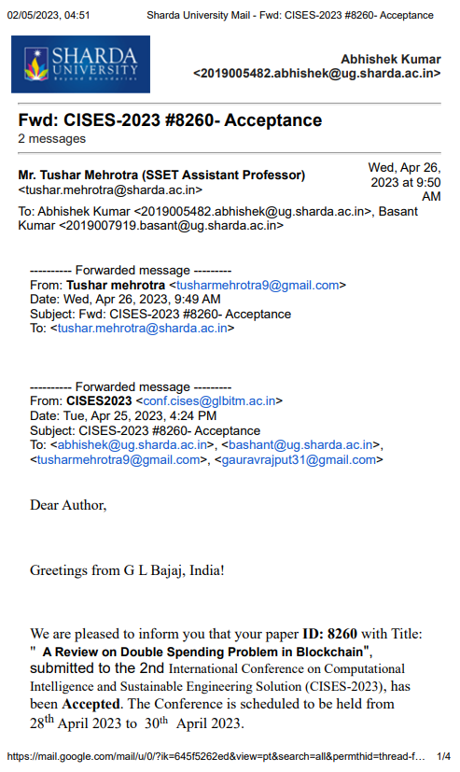
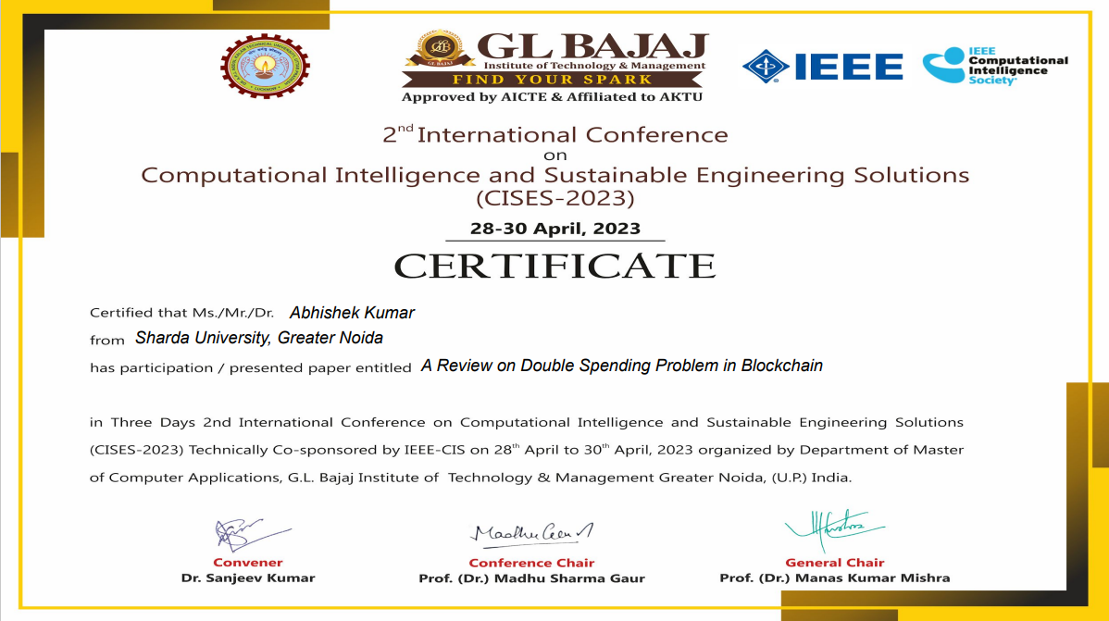
Proof of the Outcome
ANNEXURE I
Review Paper for the said project has been accepted in 2nd IEEE-International Conference on Computational Intelligence and Sustainable Engineering (CISES-2023).
Paper Title: A Review on Double Spending Problem in Blockchain
Authors: Abhishek Kumar, Bashant Kumar Sah, Tushar Mehrotra and Gaurav Rajput

Slide 25
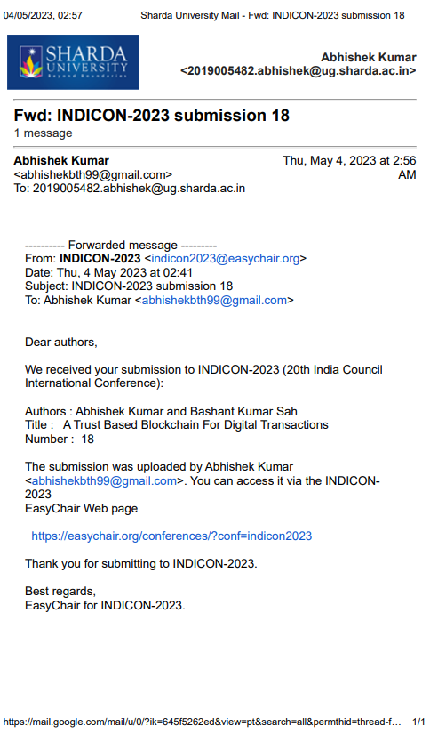
Proof of the Outcome
ANNEXURE II
Review Paper for the said project has been accepted in 20th India Council International Conference (INDICON-2023).
Paper Title: A Trust Based Blockchain For Digital Transactions
Authors: Abhishek Kumar, Bashant Kumar Sah, Tushar Mehrotra

Slide 26
Thank you

